Slide 1
Girl Scouts Cookie Booth Locations
Anju Nair
March 1, 2021

Slide 2
Cookie booth locations = Happy troopers
With Covid-19, door-to-door sales have become impossible
Cookie booth is a great alternative solution
Objective - Top 10 locations to set up Cookie booths
Interest:
My daughter’s troop
Other Girl Scout troops in town

Slide 3
Data acquisition and cleaning
Geospatial coordinates of NY – 5 boroughs and 306 neighborhoods
8 Neighborhoods within 3-mile radius of Grasmere, Staten Island, NY
Location data from Foursquare,
3150 venues in Staten Island Borough
400 venues in neighborhoods of interest
65 missing venue categories were dropped
Cleaned dataset had 135 unique categories
Foursquare Recovery Index for foot traffic data

Slide 4
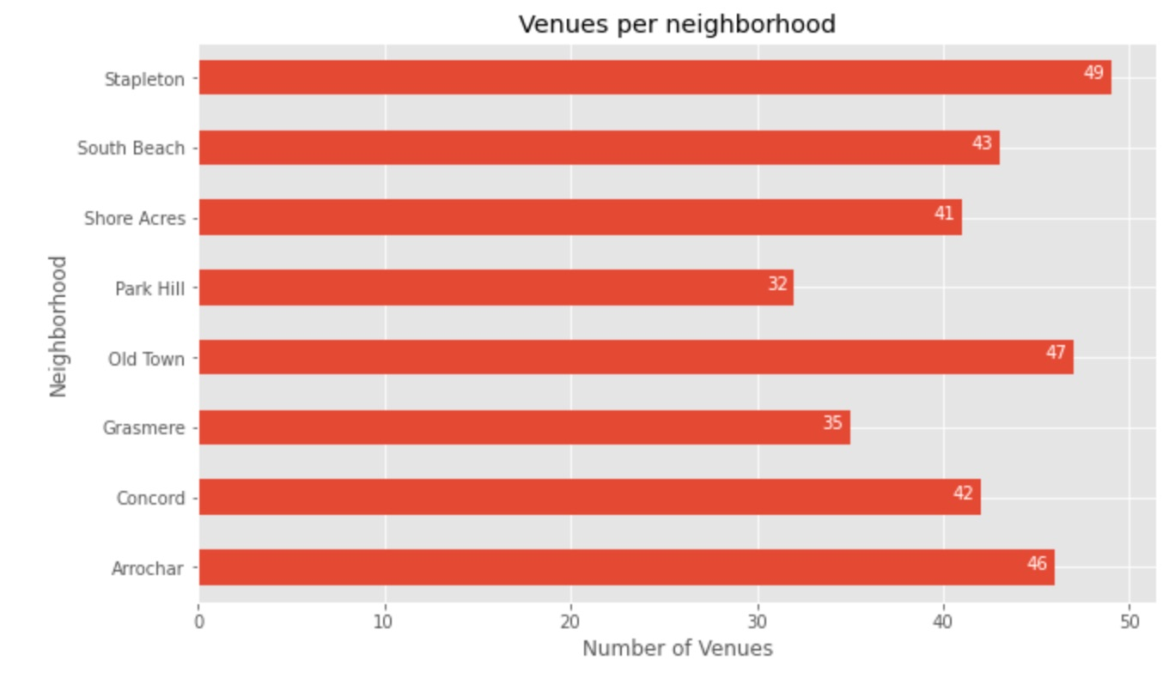
Count of venues by neighborhood
Each of the neighborhoods have similar number of venues though they vary in category.

Slide 5
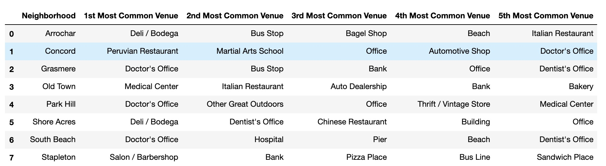
Top 5 common venues by frequency
Based on frequency, the above lists the venues for each neighborhood.

Slide 6
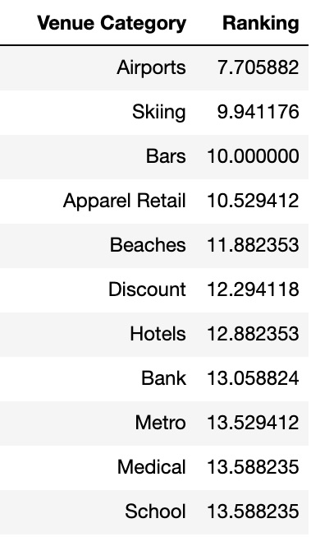
Most visited venues after COVID-19 stay-at-home orders lifted
The above is the mean ranking of the foot traffic data from Foursquare Recovery Index.
Low score indicative of venue that is most visited.

Slide 7
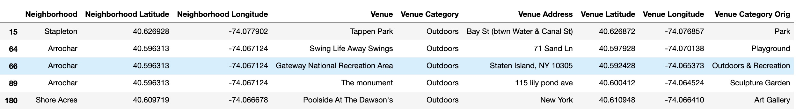
Mapping of Recovery Index category to Neighborhood venue category
Focus on ‘Venue Category’ and ‘Venue Category Orig’.
The above is an example of the ‘Outdoors’ category found in Recovery Index.
The categories in the neighborhoods of interest vary from Park, Playground and
Outdoors & Recreation. They are consolidated into ‘Outdoors’ category.

Slide 8
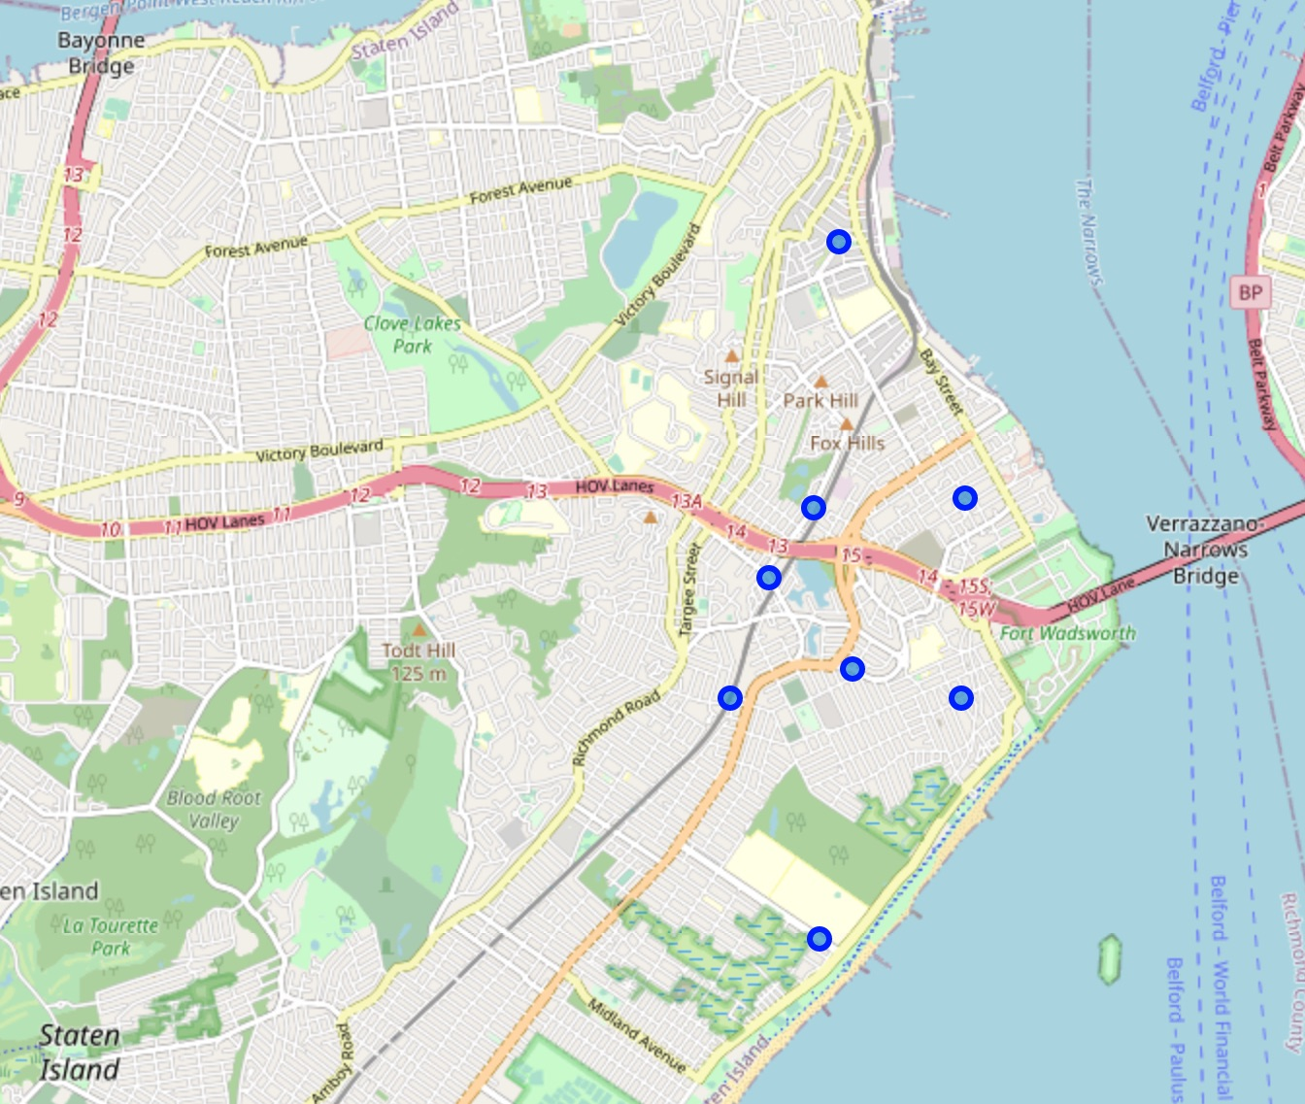
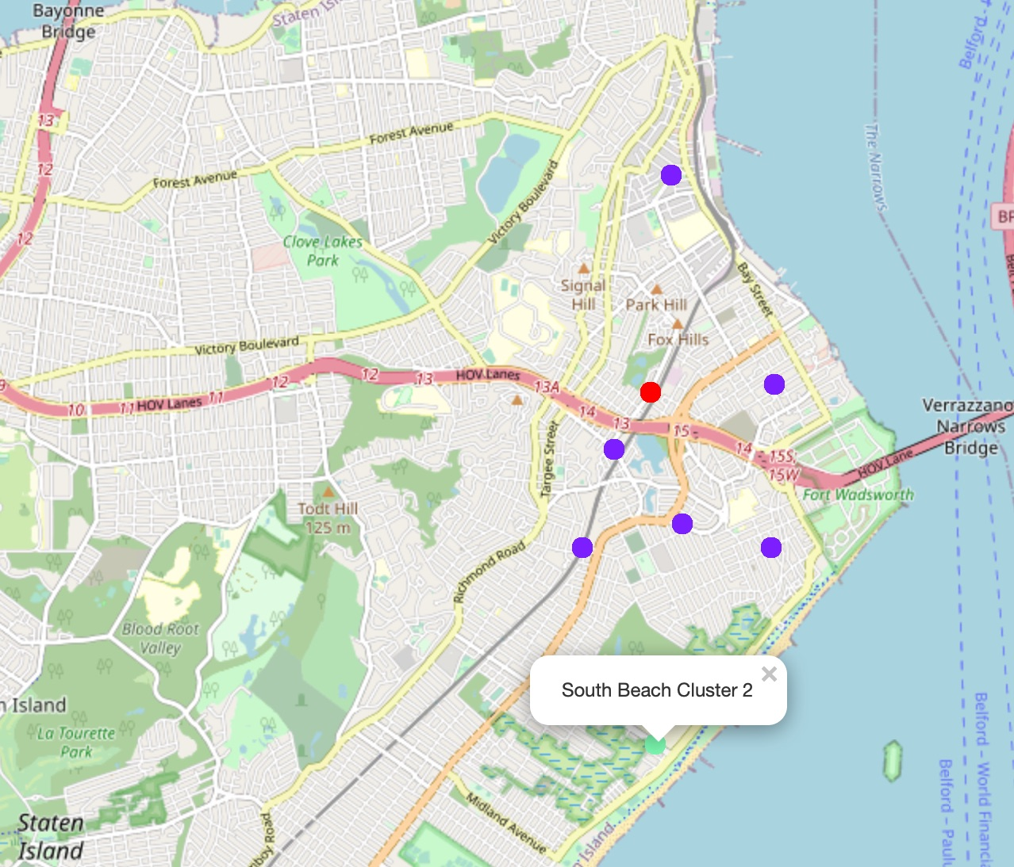
Clustering of neighborhoods of interest
After Clustering
Before Clustering
After clustering, the target towns were set to 6 neighborhoods.

Slide 9
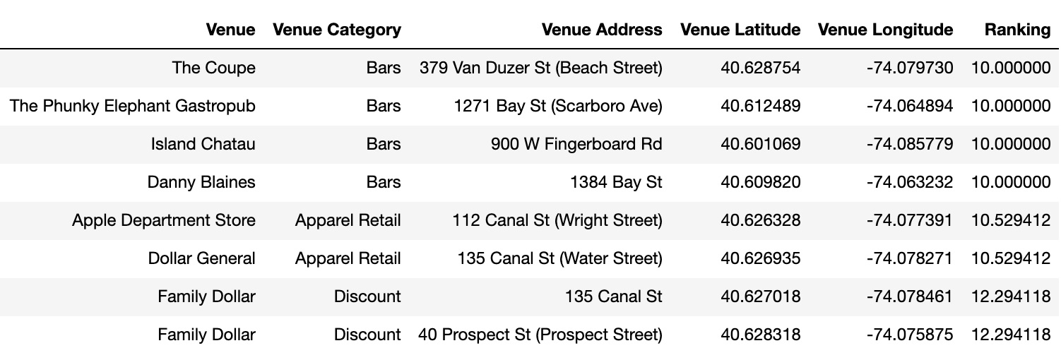
Results
Interesting : Venues in the target towns reveal that ’Bars’ are the most frequented venue.
The undesired locations will be filtered to reveal the top 10 preferred locations.

Slide 10
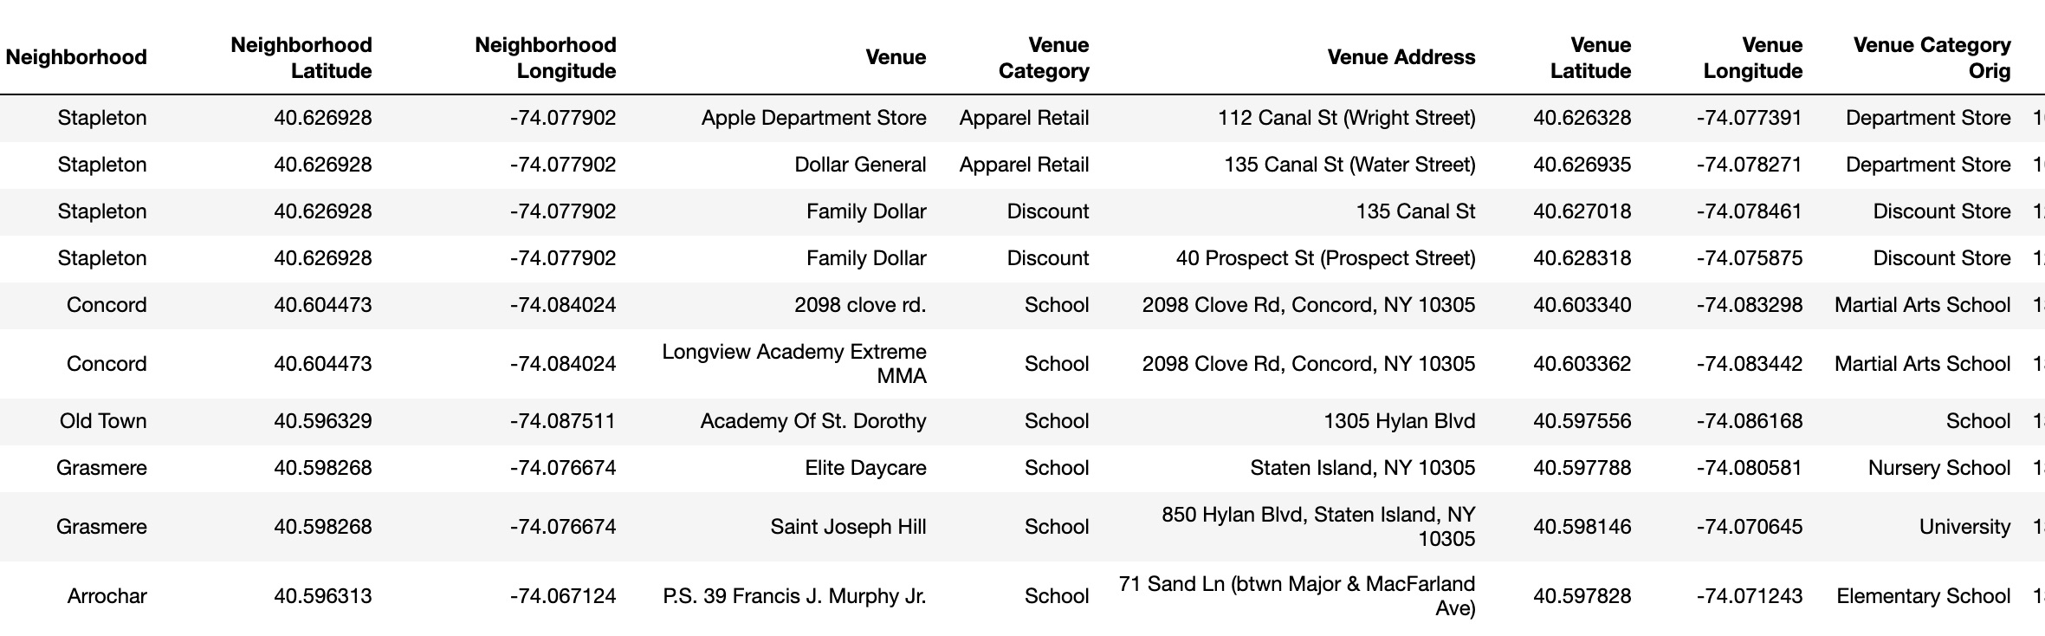
Results after clean-up
The above are the preferred top 10 locations to target to maximize cookie sales.
First venue: Apparel Retail
Second venue: Discount stores
Third venue: Schools

Slide 11
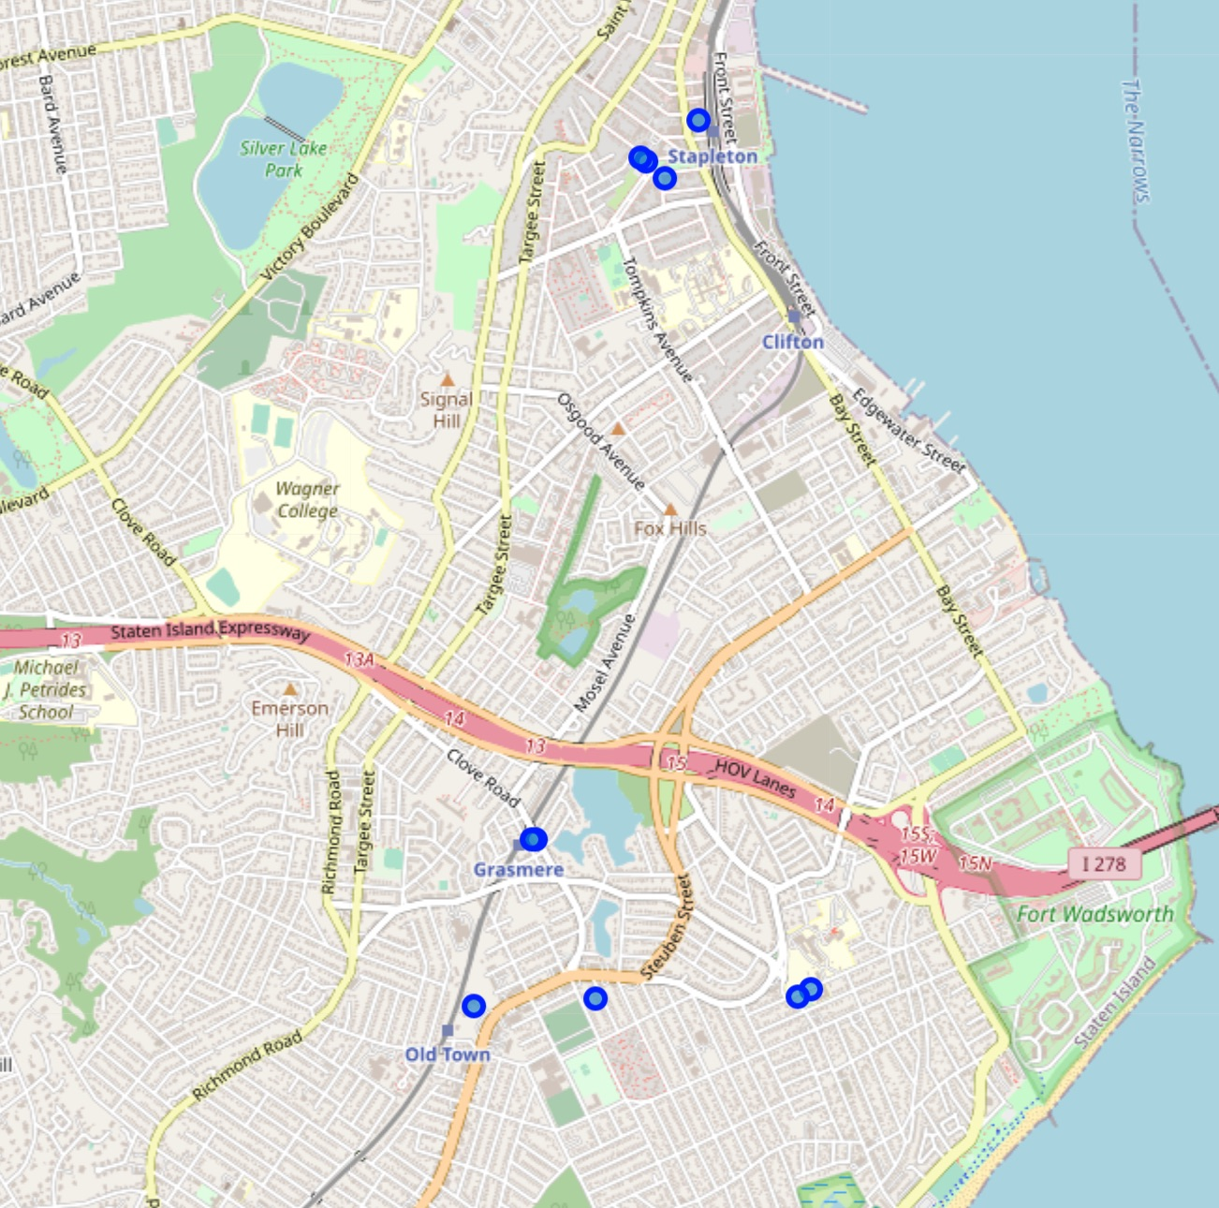
Locations
The above marks the locations of the preferred venues.

Slide 12
Future Directions
Real-time foot traffic data will improve predictions
Weather data may be combined

